Slide 1
Chapter 4 Sections 2 & 3
The Assyrian and Persian Empires

Slide 2
Section 2 – The Assyrian Empire
A Mighty Military Machine
Assyria
• Assyria uses _________________ might to acquire empire across
Southwest Asia
The Rise of a Warrior People
• After invasions in Mesopotamia, Assyrians develop warlike
behavior
• Assyrian king _____________________ brutally destroys enemies
Military Organization and Conquest
• Glorified armies wear metal armor, copper helmets, leather
protection
• Use iron weapons, ______________________ skill, and brute force
to conquer cities
• _____________, ________________, or __________________ captive
peoples to distant lands

Slide 3
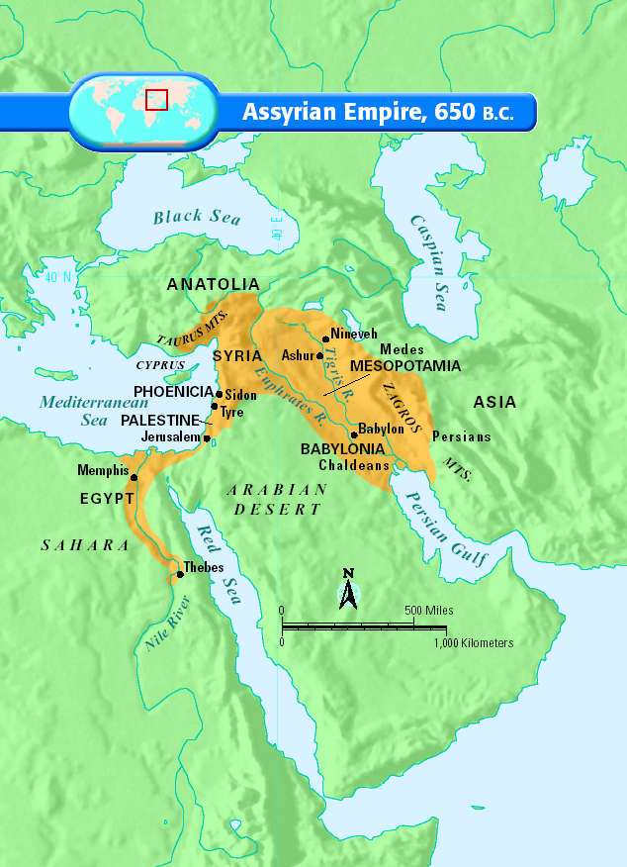

Slide 4
The Empire Expands
Kings of Assyria
• Defeat Syria, Palestine, Babylonia between 850 and 650 B.C.
Assyrian Rule
• Creates a central authority over ______________ governors of dependent regions
• Collects ___________ and ________________ from conquered
lands
Assyrian Culture
• Rulers build great cities, including capital at _______________
• Carved sculptures of military campaigns and the lion hunt
• King Ashurbanipal builds library of ______________ tablets;
Epic of Gilgamesh

Slide 5
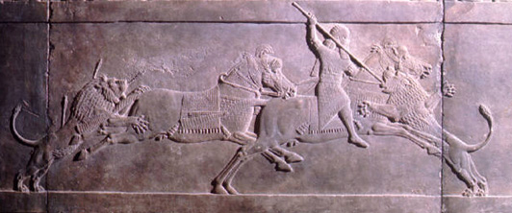
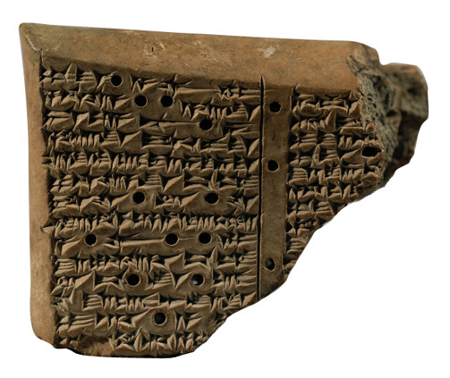
King Ashurbanipal killing a lion (about 645 B.C.). Palace of Ashurbanipal, Nineveh.
Cuneiform tablet with Code of Hammurabi (copy; original about 1750 B.C.).

Slide 6
Rebirth of Babylon Under the Chaldeans
Early Warnings
• Empire _______________________, __________________ earns
many enemies, Ashurbanipal dies
Decline and Fall
• Army of Medes and Chaldeans destroys Nineveh (612 B.C.);
library survives
Rebirth of Babylon Under the Chaldeans
• Chaldeans make Babylon capital of own empire
• King Nebuchadnezzar builds legendary
_________________________________________________
• Builds tall ziggurats; astronomers make discoveries about
____________________________
• Chaldean Empire falls to Persians; they adopt Assyrian inventions

Slide 7
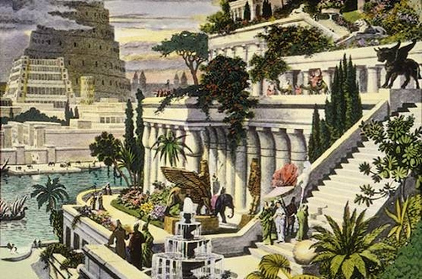
Hanging Gardens of Babylon

Slide 8
Section 3 – The Persian Empire
The Rise of Persia
The Persian Homeland
• Persia (ancient _____________) has fertile land and minerals
• Medes and Persians rose to power there
Cyrus the Great Founds an Empire
• Starting in 550 B.C., Persian king Cyrus conquers neighboring
lands
• Governs with _____________________ toward conquered peoples
• Honors local customs, including religious ones
• Allows ______________ to return to Israel to rebuild temple of
Jerusalem

Slide 9
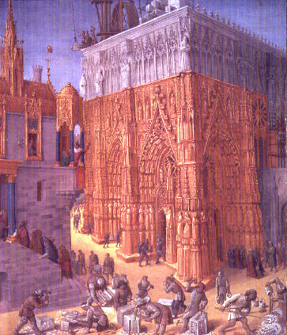
Construction of temple of Jerusalem under Solomon.Manuscript (15th century), Jean Fouquet.

Slide 10
Persian Rule
Cambyses and Darius
• Cyrus’s son, Cambyses, conquers Egypt but rules
_______________________
• Darius seizes control, establishes __________________; expands
empire to India
Provinces and Satraps
• Darius divides empire into 20 areas of local administration
• Appoints satraps — ____________________—to rule each area
• Builds _________________________ to make communication
within empire easier
• Issues _______________ that can be used throughout the empire

Slide 11
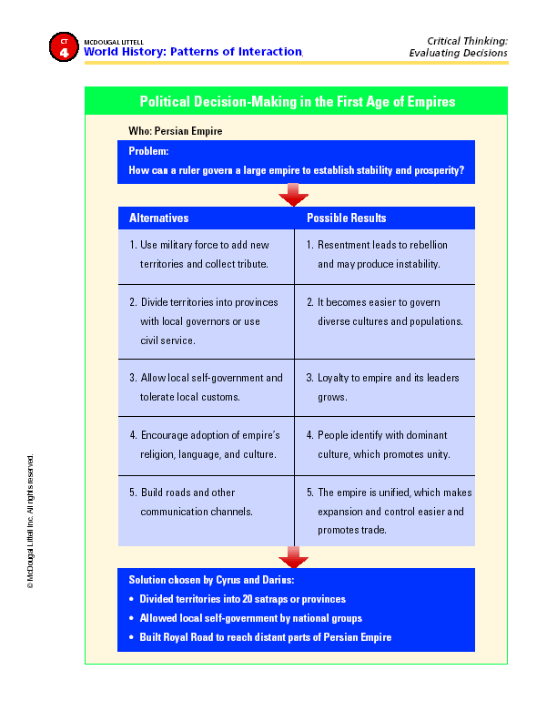

Slide 12
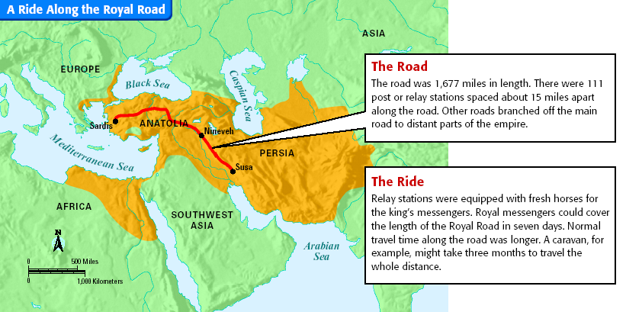

Slide 13
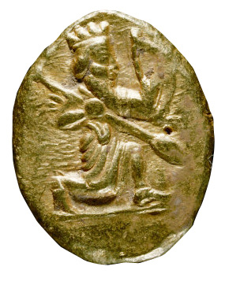
Persian gold stater (coin) used in Egypt after Persian conquest (5th century B.C.).

Slide 14
The Persian Legacy
Zoroaster
• Persian thinker called Zoroaster develops new _______________
Zoroaster’s Teachings
• Life is a battleground between ____________ and ____________
• ________ god will judge us by how well we fight for good
• Zoroastrianism influenced Judaism, Christianity, and Islam
Political Order
• Through ___________________ and good government, Persians
bring political order
• Preserve earlier cultures, find new ways to live and rule

Slide 15
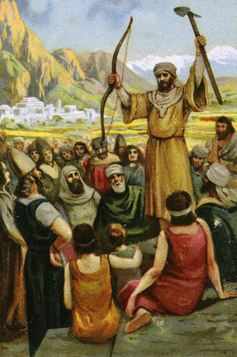
Zoroaster, Persian prophet (about 628-551 B.C.), educating his people.

