Slide 1
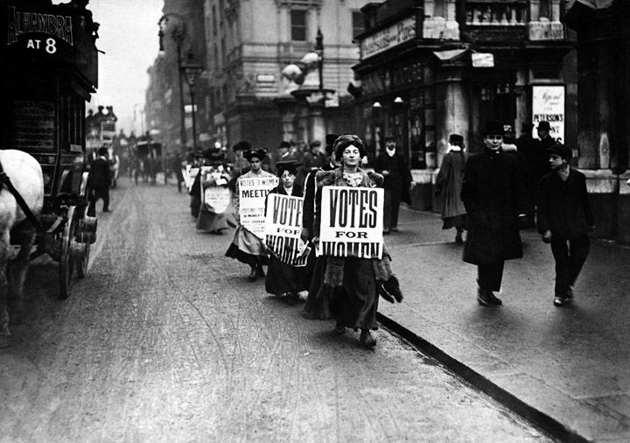
Chapter 26 - An Age of Democracy and Progress, 1815–1914
Democratic ideals strongly affect Europe and its colonies, the United States expands its borders, and technology and science change daily life.
Women march for the right to vote.
NEXT

Slide 2
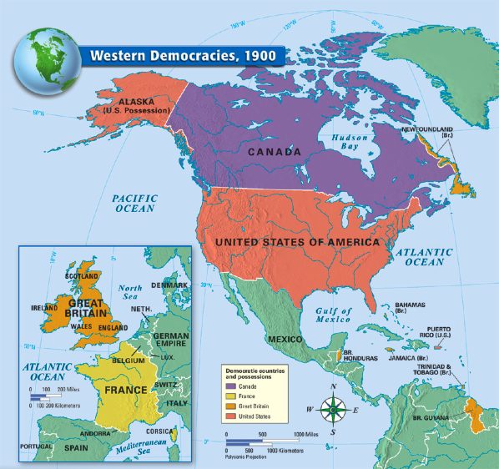

Slide 3
SECTION
Democratic Reform and Activism
Britain Enacts Reforms
1
A Severely Limited Democracy
• In the early 1800’s, voting was limited to _______________ with substantial property
• Women could not vote at all; the upper classes (______%) run the government
The Reform Bill of 1832
• 1832 bill gives the middle class ___________________________ — the right to vote
• Also gives thriving new industrial cities more _________________________________
Chartist Movement
• Chartist movement — expands _________________________ and reforms politics
• Demands suffrage for all men, a ________________ vote, and Parliamentary reforms
• Parliament at first rejects, but eventually adopts Chartist goals
The Victorian Age
• Queen Victoria — rules for 64 years at height of British power
• Loses power to Parliament, especially the ____________________________________
• Government is run almost completely by the _________________________________

Slide 4
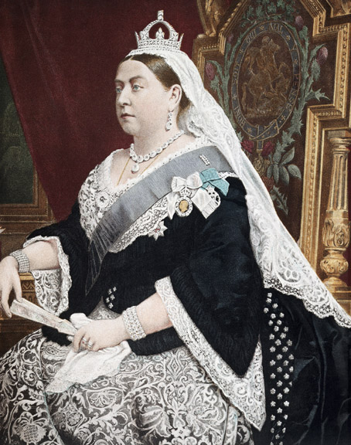
Portrait of Queen Victoria. Painting (1886), Alexander Basano.

Slide 5
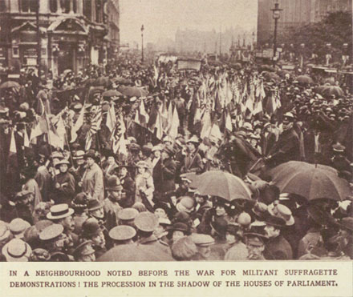
Women Get the Vote
Organization and Resistance
• Many women organize to win the right to
vote
• Some argue against it as too __________________ a break from tradition
• Others say women do not have __________________ to engage in politics
Militant Protests
• Emmeline Pankhurst forms Women’s
Social and Political Union
• After 1903, WSPU members protest, go
to jail, stage hunger strikes
• Women do not win suffrage in Britain
and U.S. until after _________________

Slide 6
France and Democracy
The Third Republic
• France changes governments repeatedly after the ___________________________
• Third Republic — French government formed in 1875, lasts 60 years
The Dreyfus Affair
• Dreyfus affair — spy controversy over _________________ officer in French army
• ______________________ — prejudice against Jews, prevalent in much of Europe
• Government eventually declares Captain Alfred Dreyfus _____________________
The Rise of Zionism
• Zionism — movement for _____________________ homeland—grows after Dreyfus affair

Slide 7
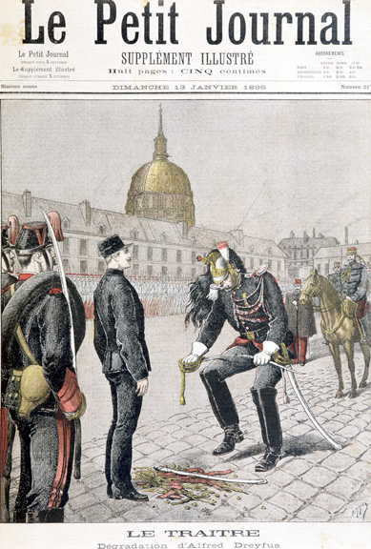
Depiction of military degradation of Alfred Dreyfus, French army officer. Le Petit Journal (January 10, 1895).

Slide 8
SECTION
Self-Rule for British Colonies
2
Canada Struggles for Self-Rule
French and English Canada
• Canada was originally home to many Native American peoples
• Later, problems between Catholic French, Protestant English settlers
• Canada split: Upper Canada (_______________), Lower Canada (________________)
The Durham Report
• This division eases tensions, but ________________________ class holds power
• _____________________ class demands more reform, producing rebellions in 1830s
• Parliament approves Lord Durham’s changes allowing more self-rule
The Dominion of Canada
• Canadians want central government to protect interests against the U.S.
• In 1867, Dominion of Canada formed
• Dominion—self-governing but part of British Empire
Canada’s Westward Expansion
• First prime minister of Canada is John MacDonald
• Expands Canada to the ___________________, then builds transcontinental railroad

Slide 9
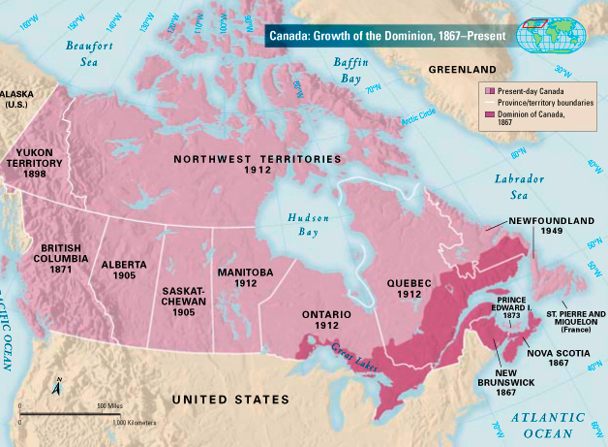

Slide 10
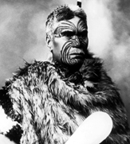
SECTION
Australia and New Zealand
2
James Cook Explores
• Captain Cook claims New Zealand (1769), part
of Australia (1770)
• Cook encounters Maori — native people of
New Zealand
• Australian native peoples called ___________________________ by Europeans
Britain’s Penal Colony
• In 1788, Britain starts colonizing Australia, makes
it ___________________________________
• Penal colony — place where convicts are sent to
serve their sentences
• Upon release, prisoners could __________________________________________
Photograph of Maori warrior with traditional dress and face markings.

Slide 11
Australia and New Zealand
Free Settlers Arrive
• Free people eventually settle both locations
• Settlers introduce ____________________; ______________ becomes major export
• Government offers cheap land to encourage immigration
Settling New Zealand
• Britain recognizes Maori land rights until conflicts in 1839
• In 1840, British recognize Maori land rights, rule New Zealand
Self-Government
• In early 1900’s, both Australia and New Zealand get limited _____________________
• In 1850’s, Australians are first to use the _____________________________________
• In 1893, New Zealand the first nation to grant women __________________________
Status of Native Peoples
• Colonists displace and kill many Maori and Aborigines
• European _____________________________ also take a heavy toll

Slide 12
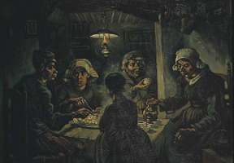
The Irish Win Home Rule
A Troubled History
• English expansion into and the domination of Ireland begins in the 1100’s
• Irish Catholic majority resents English laws favoring ____________________
The Great Famine
• Irish peasants depend heavily on
____________________________ for nourishment
• 1845-1848 potato famine destroys
entire crop; one million out of eight
million people ______________
• Millions flee Ireland to ________________________________________________________________________________________________

Slide 13
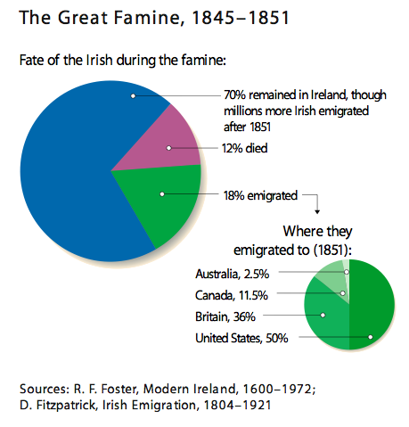

Slide 14
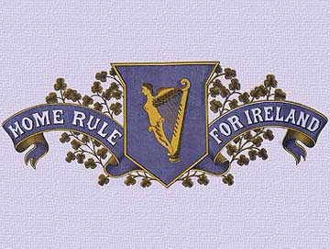
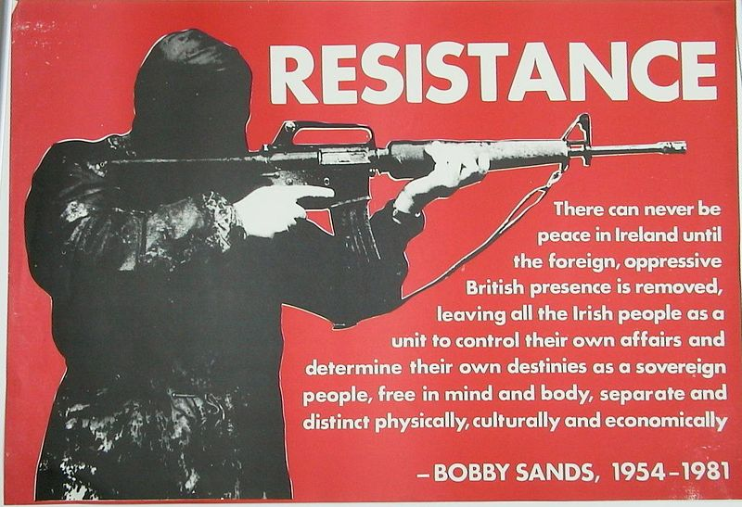
The Irish Win Home Rule
Demands for Home Rule
• Many Irish want home rule — local
control over internal affairs
• Home rule finally granted in 1914,
postponed by ______________________
Rebellion and Division
• Frustrated Irish nationalists stage failed
Easter uprising in 1916
• Irish Republican Army — unofficial military
force seeking independence
• In 1921, Ireland splits; Northern Ireland
remains part of _____________________
• South becomes Irish Free State, then
Republic of Ireland in ________________

Slide 15
SECTION
War and Expansion in the United States
3
Americans Move West
Manifest Destiny
• Manifest destiny — U.S. has a duty to rule _______________________________
• U.S. pushes Native Americans continuously west to worse lands
Texas Joins the United States
• American settlers enter Texas, grow unhappy with Mexican rule
• Win independence in 1836; U.S. annexes Texas in ___________________
War with Mexico
• In 1848, U.S. wins Mexican War, gains the southwest and _____________________
• In 1853, Gadsden Purchase establishes current U.S. boundaries

Slide 16
Civil War Tests Democracy
North and South
• North uses _________________ labor, has both farms and industry
• South depends on _______________ labor, grows a few cash crops (mainly cotton)
• Slavery fuels disagreement over states’ rights versus federal rights
Civil War Breaks Out
• Abraham Lincoln — elected in 1860; he is fiercely opposed by the South
• Southern states _______________________ — withdraw from the Union
• U.S. Civil War — North defeats South after bitter fighting (1861–1865)
Abolition of Slavery
• Emancipation Proclamation — Lincoln declares all southern slaves free
• North’s army frees slaves as they push farther south
• Amendments after the war extend ________________________________ & _______________________________________ to blacks

Slide 17
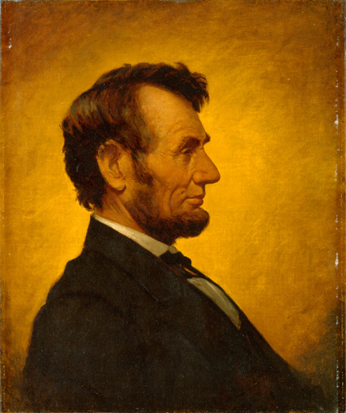
Abraham Lincoln, 16th president of the United States. Portrait (1864), William Willard.

Slide 18
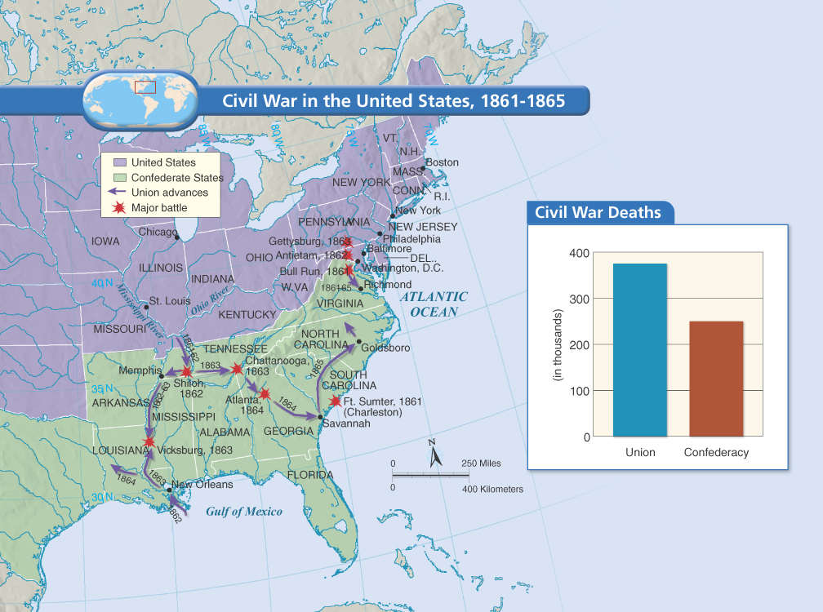

Slide 19
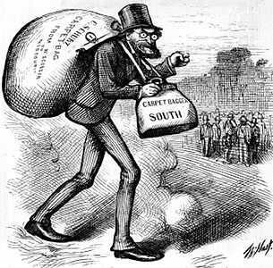
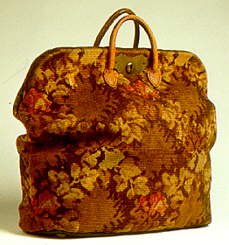
Civil War Tests Democracy
Reconstruction
• From 1865 to 1877, northern troops
occupy South, enforce new laws
• After Reconstruction, troops leave and
Southerners pass new laws
• ________________________________ — separation of blacks and whites becomes policy in South
"'The Man with the (Carpet) Bags' cartoon by Thomas Nast, 1872, depicting the Southern attitude toward Northerners during Reconstruction"

Slide 20
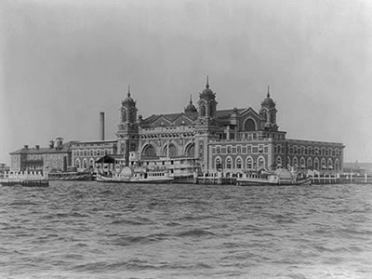
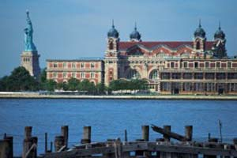
The Postwar Economy
Immigration
• By 1914 more than _________ million
immigrants arrive from Europe and Asia
• Most immigrants settle in the West,
Midwest, or Northeastern U.S.
• Immigrants provide the workforce
needed for _______________________
The Railroads
• Transcontinental railroad links east and
west U.S. in 1869
• Almost ____________________ miles of track cross U.S. by 1900
• Railroads allow quick movement of goods
and raw materials

Slide 21
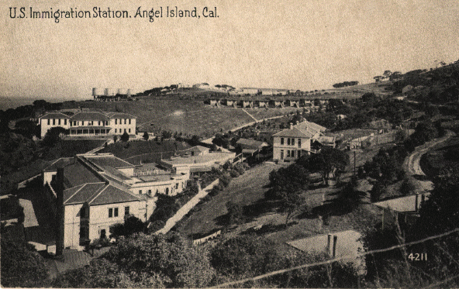
Immigration Station, circa 1918. Administration building in left foreground, Hospital in left background, Detention Barracks in mid-center, Julia Morgan-designed employee cottages at back, Perimeter Road on right.

Slide 22
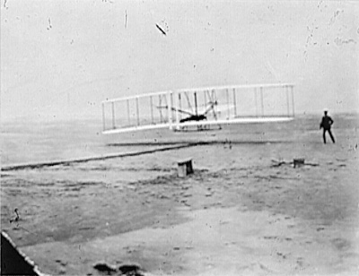
SECTION
Nineteenth-Century Progress
Inventions Make Life Easier
4
Edison the Inventor
• Thomas Edison patents over ______________ inventions in research laboratory
Bell and Marconi Revolutionize Communication
• In 1876, Alexander Graham Bell invents ___________________________
• In 1895, Italian Guglielmo Marconi builds first radio
Ford Sparks the Automobile Industry
• In 1880’s, Germans invent first automobile
• Henry Ford lowers cost with
________________________________ — one task per worker
The Wright Brothers Fly
• In 1903, Wright brothers develop first
working airplane

Slide 23
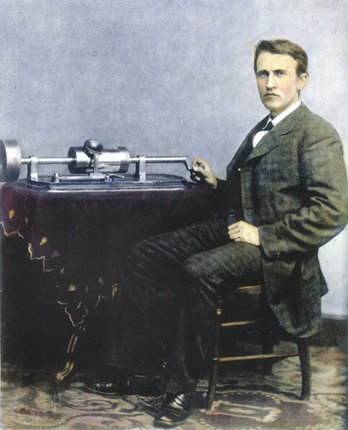
Edison with Cylinder Phonograph, April 1878.

Slide 24
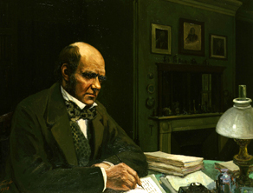
New Ideas in Medicine
The Germ Theory of Disease
• Louis Pasteur discovers existence of bacteria while observing fermentation
• He and others quickly discover that bacteria cause disease
• British surgeon Joseph Lister links bacteria to surgical problems
• Sterilizing instruments reduces deaths from infection
• Medical researchers develop _______________________; cities improve sanitation
New Ideas in Science
Darwin Challenges Traditional Beliefs
• Charles Darwin — English scientist
develops theory of ______________________
• In 1880’s most people believe in
“special creation” by God
Charles Darwin (1809-1882), English naturalist.

Slide 25
New Ideas in Science
Darwin’s Theory of Evolution
• Darwin’s idea of natural selection says competition elevates the fittest
• The fittest then breed and their offspring share their advantages
• Gradually, over generations, species change; new species evolve
• Theory of evolution — species change slowly through natural selection
Mendel and Genetics
• Austrian monk Gregor Mendel discovers patterns to inherited traits
• Mendel’s work begins the science of genetics
Advances in Chemistry and Physics
• In 1803, John Dalton theorizes all matter is made of _____________________
• In 1869, Dmitri Mendeleev creates periodic table of the elements
• ________________________ — type of energy discovered by Marie and Pierre Curie
• Ernest Rutherford says atoms have a nucleus surrounded by electrons

Slide 26
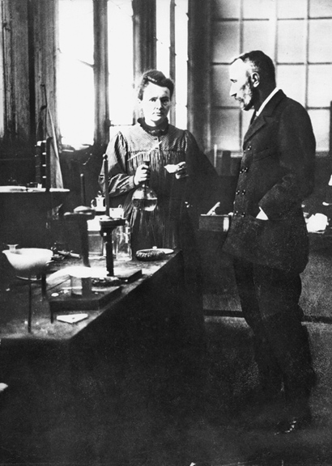
Marie and Pierre Curie, noted for their work on radioactivity, in their laboratory in France. Photograph (1896)

Slide 27
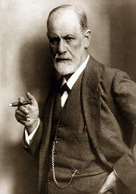
Social Sciences Explore Behavior
New Ideas in Social Science
• Sciences of archaeology, sociology,
anthropology begin in 1800’s
• _______________________________________ — study of human mind and
behavior
• Ivan Pavlov believes human actions are
actually _________________________________ reactions
• Sigmund Freud studies the unconscious;
develops psychoanalysis
• Freud and Pavlov shake the Enlightenment’s faith
in reason

Slide 28
Social Sciences Explore Behavior
Sigmund Freud, born (May 6, 1856 – September 23, 1939), was an Austrian psychiatrist who founded the psychoanalytic school of psychology.^{[1]} Freud is best known for his theories of the unconscious mind and the defense mechanism of repression and for creating the clinical practice of psychoanalysis for curing psychopathology through dialogue between a patient and a psychoanalyst. Freud is also renowned for his redefinition of sexual desire as the primary motivational energy of human life, as well as his therapeutic techniques, including the use of free association, his theory of transference in the therapeutic relationship, and the interpretation of dreams as sources of insight into unconscious desires.

Slide 29
The Rise of Mass Culture
From Leisure Culture to Mass Culture
• Mass culture — art, music, writing, and entertainment for large audience
Changes Produce Mass Culture
• Leisure activities (movies, music) now available to ____________________________
Music Halls, Vaudeville, and Movies
• Traveling acts feature music, juggling, dancing
• In 1880’s, people develop early projections of moving images
• By the early 1900’s, filmmakers produce the first feature films
Sports Entertain Millions
• Spectator sports draw huge crowds; modern Olympics in Greece, _______________

Slide 30
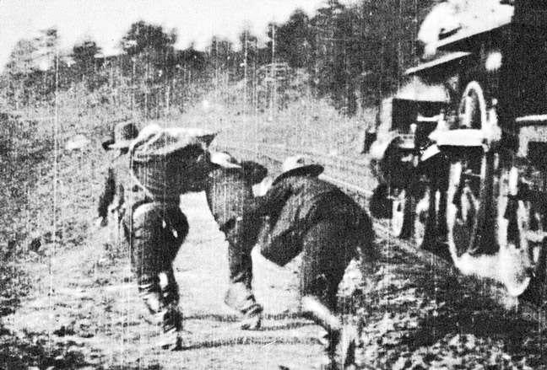
Image from the movie The Great Train Robbery (1903).

